Slide 1
L04 - Software Models
Software is complex
  often more than what people can handle
  not necessary to know all details at all times
Models offer simplified view
  concentrate on the important issues and omit the clutter
    help to deal with software complexity
  Different models are needed in different contexts
© 2012 Václav Rajlich Software Engineering: The Current Practice Ch. 4

Slide 2
Roles of software models
Predictive (Designs)
  created up-front, before implementation starts
  predict how the software will be like
  helpful for resource planning and risk assessment
  actual implementation may deviate from it
Extracted
  extracted from an existing system, by analysis of the properties of the software
  help answer specific questions about the software
© 2012 Václav Rajlich Software Engineering: The Current Practice Ch. 4

Slide 3
Roles of software models (2)
Prescriptive
  correspond to an existing system and its code
  set of rules on how to evolve the software
  software engineers must guarantee that the models remain valid after they change the code
  define constraints that need to be preserved during evolution
© 2012 Václav Rajlich Software Engineering: The Current Practice Ch. 4

Slide 4
Criteria for successful software modeling
Need to understand which details are essential and which are not
  the important properties need to be retained by the model
Models that miss important information are misleading and can lead to mistakes
© 2012 Václav Rajlich Software Engineering: The Current Practice Ch. 4

Slide 5
UML (Unified Modeling Language)
Readable
  serves as a communication between the customer and the developer
  widely used
Helps comprehension of the system
© 2012 Václav Rajlich Software Engineering: The Current Practice Ch. 4

Slide 6
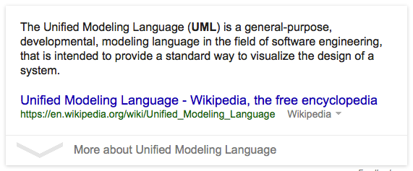
UML diagrams
Structure diagrams
  class diagrams
  component diagram
  package diagram
  implementation diagram
Behavior diagrams
  activity diagram
  sequence diagram
  collaboration diagram
  state diagram
  use case diagram
Supported by tools: Rational Rose,Visio,Violet …
  http://www.codingthearchitecture.com/2007/07/20/whats_your_uml_tool_of_choice.html
© 2012 Václav Rajlich Software Engineering: The Current Practice Ch. 4
Notes:
http://www.codingthearchitecture.com/2007/07/20/whats_your_uml_tool_of_choice.html

Slide 7
UML class diagrams
Structural diagrams
Represent the classes in the system and their relationships
Can have different levels of precision and completeness
Independent of the software technologies
© 2012 Václav Rajlich Software Engineering: The Current Practice Ch. 4

Slide 8
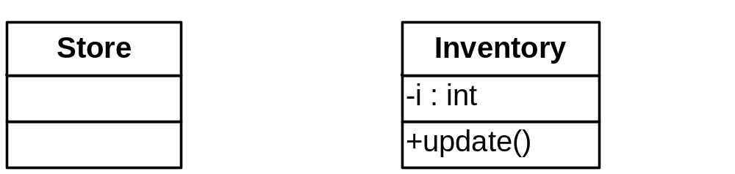
Class representation
3 compartments
  class name
  attributes (data members)
  operations (function members)
Supports different levels of detail
  class name only
© 2012 Václav Rajlich Software Engineering: The Current Practice Ch. 4

Slide 9
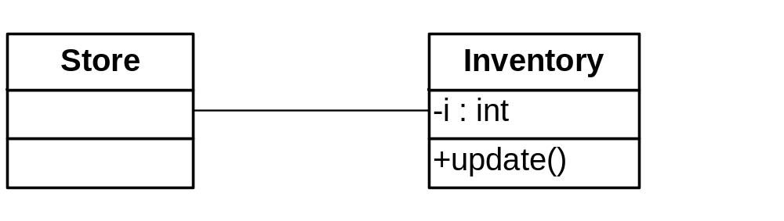
Association
Associations are lines connecting class symbols
© 2012 Václav Rajlich Software Engineering: The Current Practice Ch. 4

Slide 10
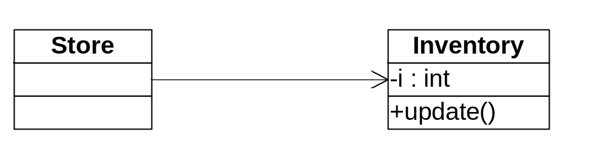
Adornments
Adornments are at the ends of paths
  arrow means navigation
© 2012 Václav Rajlich Software Engineering: The Current Practice Ch. 4

Slide 11
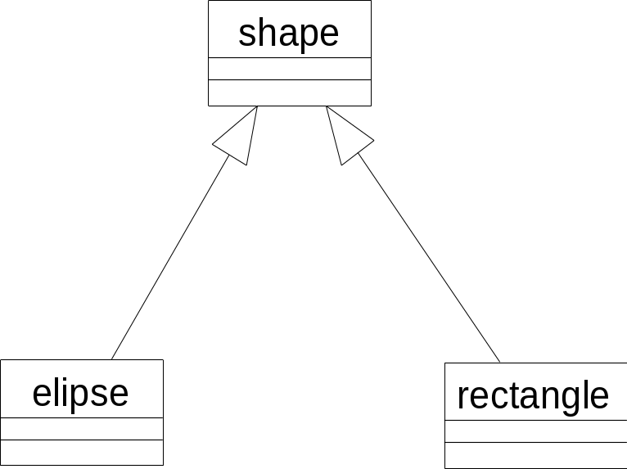
Generalization (inheritance)
“Is-a” relationship
  rectangle is a shape
  ellipse is a shape
© 2012 Václav Rajlich Software Engineering: The Current Practice Ch. 4

Slide 12
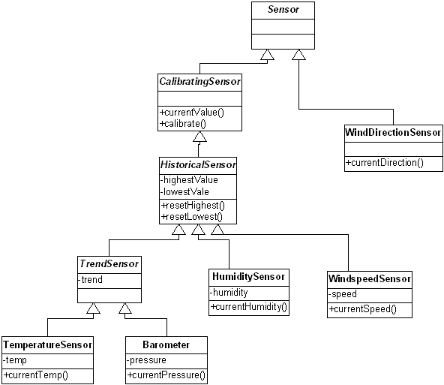
Generalization hierarchies
© 2012 Václav Rajlich Software Engineering: The Current Practice Ch. 4

Slide 13
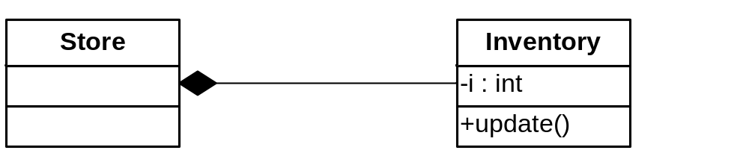
Composite/component
“Part-of” relationship
  inventory is part of a store
© 2012 Václav Rajlich Software Engineering: The Current Practice Ch. 4

Slide 14
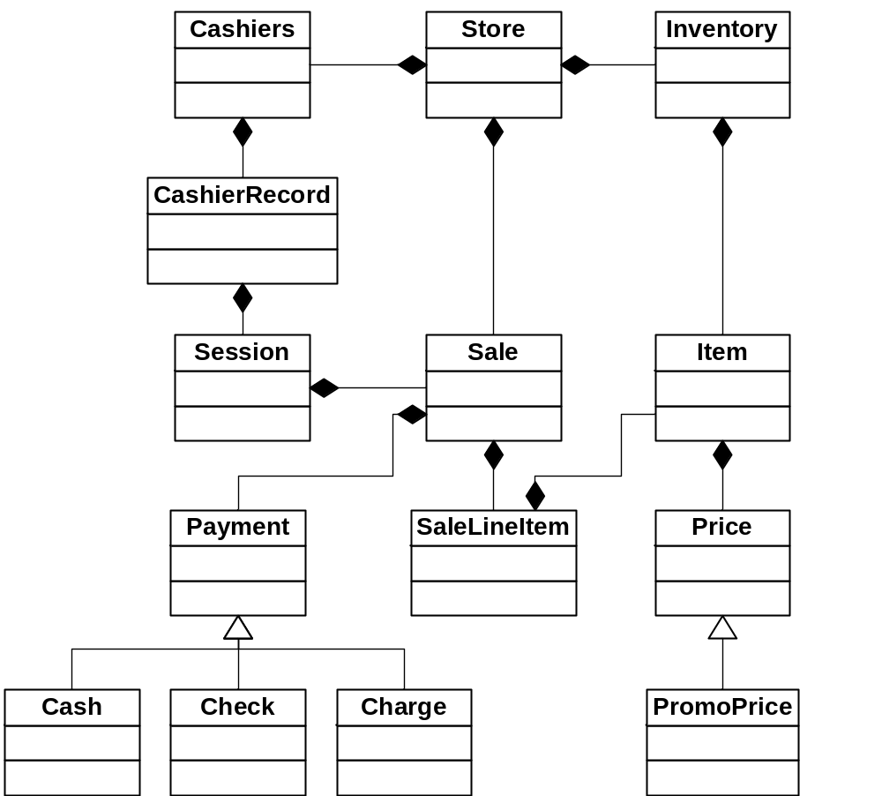
PoS
© 2012 Václav Rajlich Software Engineering: The Current Practice Ch. 4

Slide 15
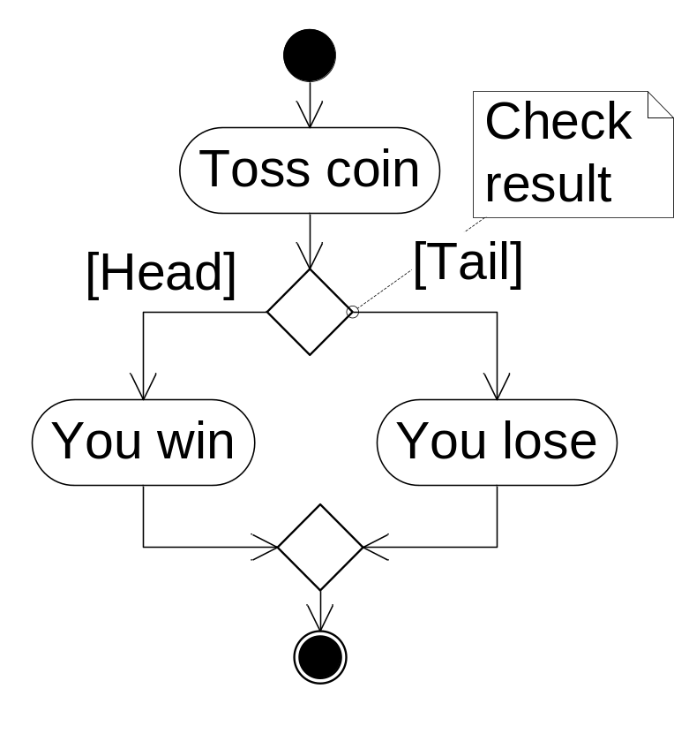
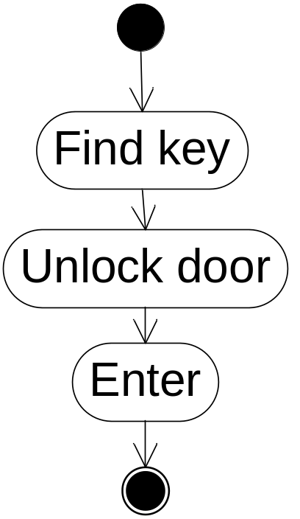
UML Activity diagram
Activities are decomposed into actions
© 2012 Václav Rajlich Software Engineering: The Current Practice Ch. 4

Slide 16
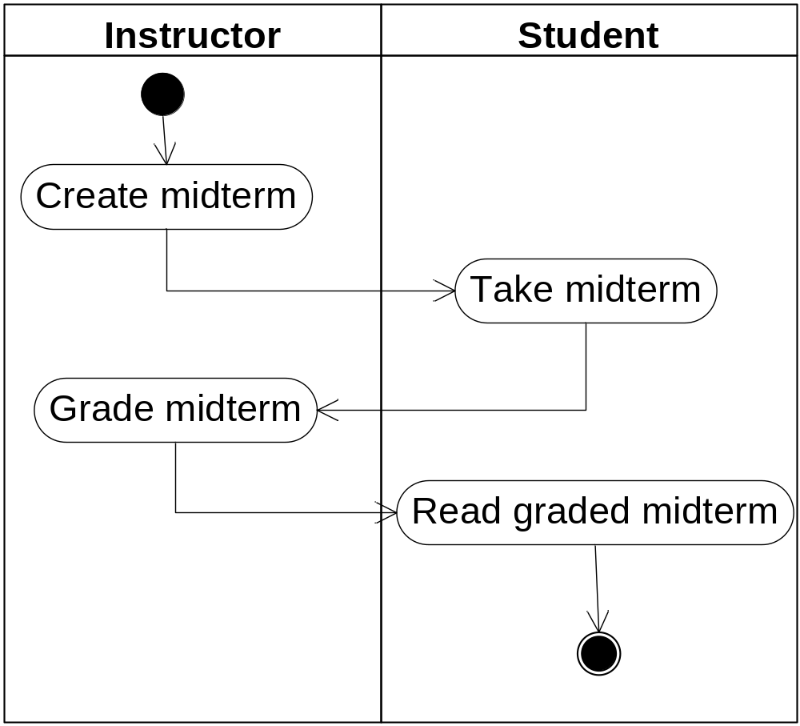
Swim lanes
© 2012 Václav Rajlich Software Engineering: The Current Practice Ch. 4

Slide 17
Class dependency graphs (CDG)
Depict classes and their dependencies
Different from UML class diagrams
  in small but significant details
Extracted form the existing code
Used during software evolution
© 2012 Václav Rajlich Software Engineering: The Current Practice Ch. 4

Slide 18
Class responsibilities
Each class in the program plays a role
  assumes a certain responsibility
  class Item is responsible for items sold in the store
Supplier class
  helps class Item to fulfill its responsibility
  class Price is supplier class of Item
© 2012 Václav Rajlich Software Engineering: The Current Practice Ch. 4

Slide 19
Clients, suppliers, dependencies
Class B helps class A to fulfill its responsibilities:
  B is supplier of class A
  A is client of class B
  there is dependency of class A on class B
    denoted (A,B)
© 2012 Václav Rajlich Software Engineering: The Current Practice Ch. 4

Slide 20
Dependency examples
If there is a part-of relation between classes A and B, there is also a dependency (A,B)
If there is a non-polymorphic inheritance of X from Y, then (X,Y) is a dependence
If there is a polymorphic inheritance between X and Y, then both (X,Y) and (Y,X) are dependencies.
© 2012 Václav Rajlich Software Engineering: The Current Practice Ch. 4

Slide 21
Definition of CDG
directed graph G = (C,D)
  vertices C are classes of the program
  edges D are dependencies
© 2012 Václav Rajlich Software Engineering: The Current Practice Ch. 4

Slide 22
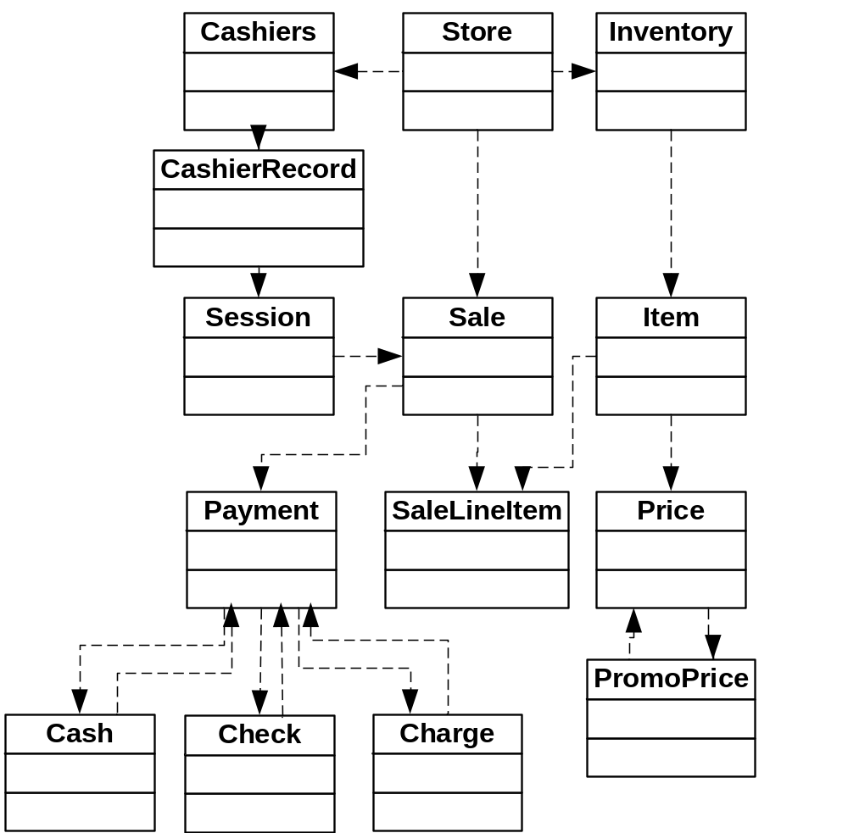
CDG
© 2012 Václav Rajlich Software Engineering: The Current Practice Ch. 4

Slide 23
Supplier slice
Set of all suppliers, suppliers of suppliers, …
Let (C,D) be a CDG
  A ∈ C be a class
  then supplier slice S(A) =
    {X | X = A or
    there is a dependency <Y, X> ∈ D such that X ∈ S(A)}
© 2012 Václav Rajlich Software Engineering: The Current Practice Ch. 4

Slide 24
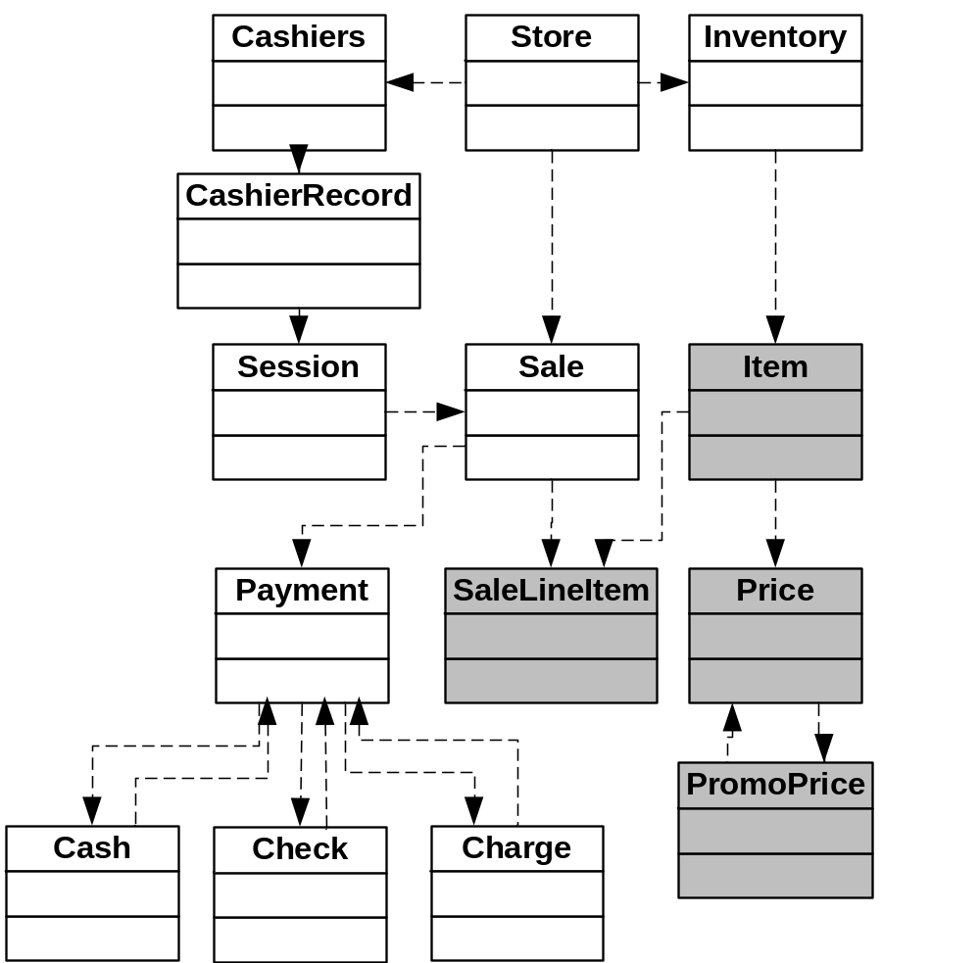
Supplier slice of
Item
© 2012 Václav Rajlich Software Engineering: The Current Practice Ch. 4

Slide 25
Class responsibilities, cont.
Local responsibility
  class assumes it alone and unaided
Composite responsibility
  assumed by the whole supplier slice
  class itself may be unable to implement everything that is expected from it
  it delegates some of the responsibilities to its suppliers
© 2012 Václav Rajlich Software Engineering: The Current Practice Ch. 4

Slide 26
Contracts
Composite responsibilities are sometimes expressed by contracts
  between a class and its clients
  clients request something
  they have to make the request within reasonable bounds
    they cannot request items that the store does not sell
Bounds are described by the precondition
Results of the action is postcondition
© 2012 Václav Rajlich Software Engineering: The Current Practice Ch. 4

Slide 27
Examples of contracts
Contract of “Average_calculator”
  precondition: A non-empty list of student names and grades
  postcondition: the grade point average
Contract of “Checking_withdrawal”
  precondition: amount to be withdrawn W, current balance in the account B, 0 ≤ W ≤ B
  postcondition: the printed check, the new balance in the account.
© 2012 Václav Rajlich Software Engineering: The Current Practice Ch. 4

Slide 28
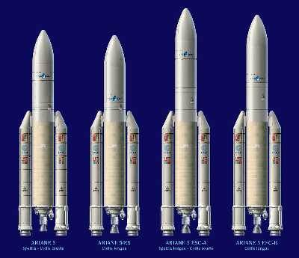
Ariane 5 disaster
Ariane is a series of rockets
European space program
Ariane 5 crashed after launch in 1996
Loss approximately half billion dollars
Cause: software error
© 2012 Václav Rajlich Software Engineering: The Current Practice Ch. 4

Slide 29
Ariane 5 software error
Inertial Reference System (IRS)
  IRS is a supplier to the rest of the software
  deals with “horizontal bias”
  precondition: horizontal bias must fit within 16-bit integer
  IRS was used in the earlier versions of Ariane
Clients of IRS in Arianne 5 violated this precondition (64 bits, converted into 16)
  https://www.ima.umn.edu/~arnold/disasters/ariane.html
Boooom!!!!
© 2012 Václav Rajlich Software Engineering: The Current Practice Ch. 4

Slide 30

Ariane 5
Notes:
Present quick story of Adriane 5 software disaster
End with but “of course no one here would allow that mistake, why should we care ….?”
Used the inertial reference platform from the Ariane 4 converted a 64bit double to a 16bit signed int

Slide 31
Formality of contracts
Contracts are described by formal logic
  special assertion language
Plain English
  verbal description of contracts
Contracts are only tacit
  not recorded anywhere
  all programmers must rediscover them
    misunderstandings and errors
    very common practice
    not recommended
© 2012 Václav Rajlich Software Engineering: The Current Practice Ch. 4

Slide 32
CDG and UML
CDG and UML class diagrams are similar
https://cppcodetips.wordpress.com/2013/12/23/uml-class-diagram-explained-with-c-samples/ - Good C++ Code Tips
Software engineers sometimes use the more popular UML class diagrams instead of CDG
© 2012 Václav Rajlich Software Engineering: The Current Practice Ch. 4

